Slide 1
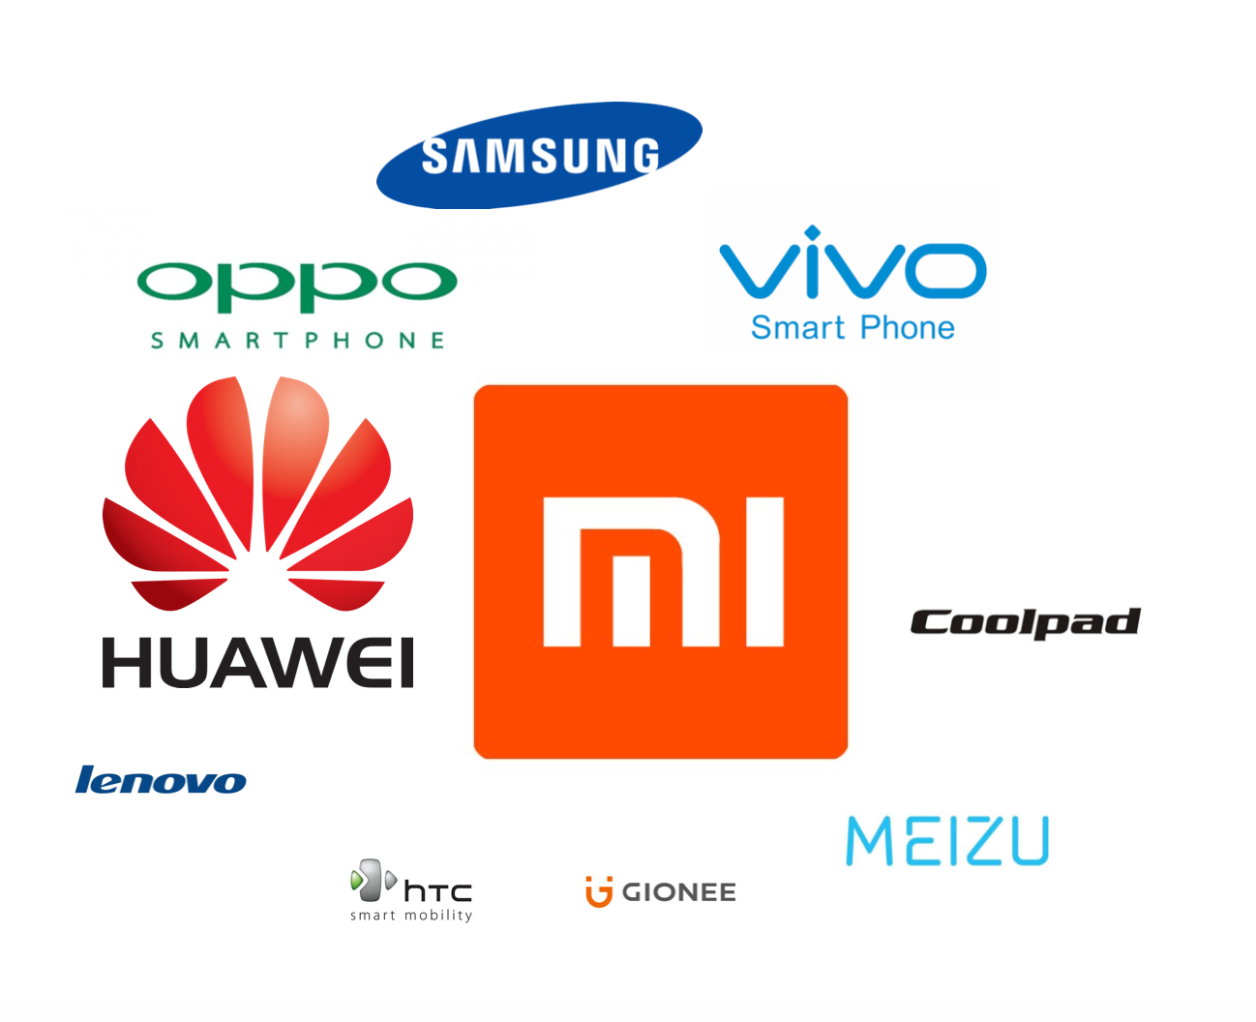
What are the most popular phone and APPs in China?
shuo zhang
07/31/2016

Slide 2
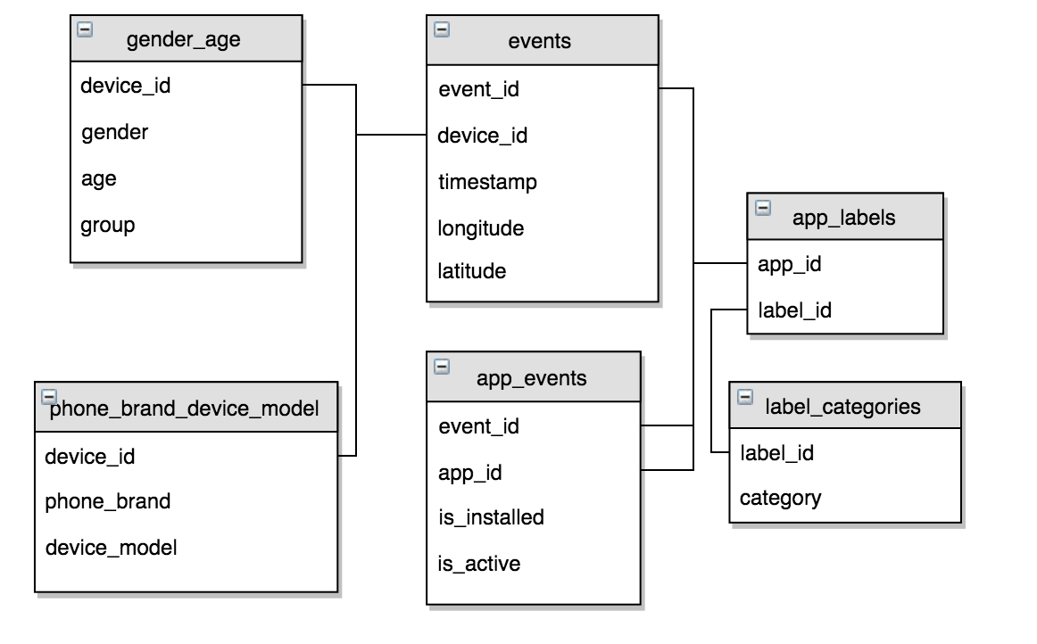
Data Description
The data set is provided by TalkingData, China’s largest third-party mobile data platform.
The data is from 05/01/2016 to 05/07/2016 and iphone data is excluded.
After data merge, two data sets are analyzed in the shiny.

Slide 3
Shiny answers
What are the most popular APP categories in China? Top 10?
What is the geographical distribution? What are the top cities that have the most users?
What is the gender distribution? Do male and female users have the same taste?
What is the age distribution? Do young and senior people have the similar preference?
What is the phone brand distribution? Do the users of different phone brands have the same preference?
What is the distribution of active APPs compared with the inactive ones?
What are the most popular phone brands in China? Top 10?
What is the geographical distribution? What are the top cities that have the most users?
What is the gender distribution? Do male and female users have the same taste?
What is the age distribution? Do young and senior people have the similar preference?

Slide 4
Discovery
Geographical, Gender and Age distribution of phone:
Top 3 cities: Beijing, Shanghai, Shenzhen
More male users than female users.
Compare Samsung Vivo and OPPO, female prefer fashion Vivo and OPPO and male prefer Samsung.
Different phone has different average user age.
Young generation prefer the fashion (and more affordable) OPPO and Vivo, while senior people prefer Huawei and Samsung . Xiaomi is the dominant.
Geographical, Gender and Age distribution of APP:
Top 3 cities: Beijing, Shanghai, Shenzhen
More male users than female users.
More inactive than active.
Different APP has different average user age.
Young and senior generation have same taste of APP preference.
Phone distribution is different dependent on phone.

Slide 5

Future Work
Build a model predicting users’ demographic characteristics based on their app usage, geolocation, and mobile device properties. Doing so will help millions of developers and brand advertisers around the world pursue data-driven marketing efforts which are relevant to their users and catered to their preferences.

